Slide 1
FunPod Prototype

Slide 2
Team Mission Statement
Our mission is to provide a more kid-friendly and effective system to help children recently diagnosed with Type 1 Diabetes. We will do this by incentivizing better care through a points system and providing feedback through analysis of data.

Slide 3
Representative Tasks
Checking blood sugar (simple)
Fast (once you are used to it)
Needs to be done several times each day
Must eat snack or cut back on insulin when blood sugar is low
Must drink water and take more insulin when blood sugar is high

Slide 4
Representative Tasks
Counting carbs (moderate)
Needs to be done when eating/snacking
Requires practice
Can cause anxiety
Can be imprecise

Slide 5
Representative Tasks
Administering insulin/bolusing (complex)
What have you eaten?
What was your blood sugar previously?
What activities will you be doing later?
What amount of insulin do you need?

Slide 6
Methods
Participants
  Males in their early 20s
  Diagnosed at 10, 12, & 13
  Compensated with coffee from Coupa/Starbucks
Environment
  Café, busy
  Cards laid out, clock
  User given appropriate card
Testing Procedure
  Note taker
  Timer
  Facilitator

Slide 7
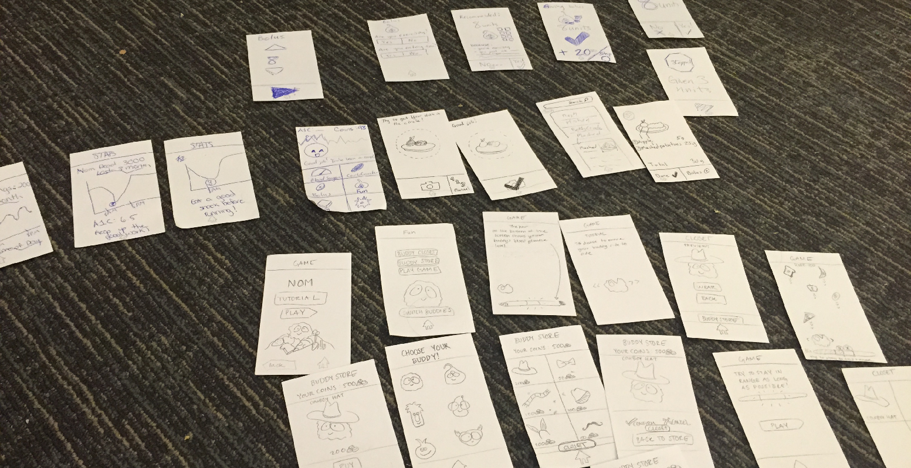

Slide 8
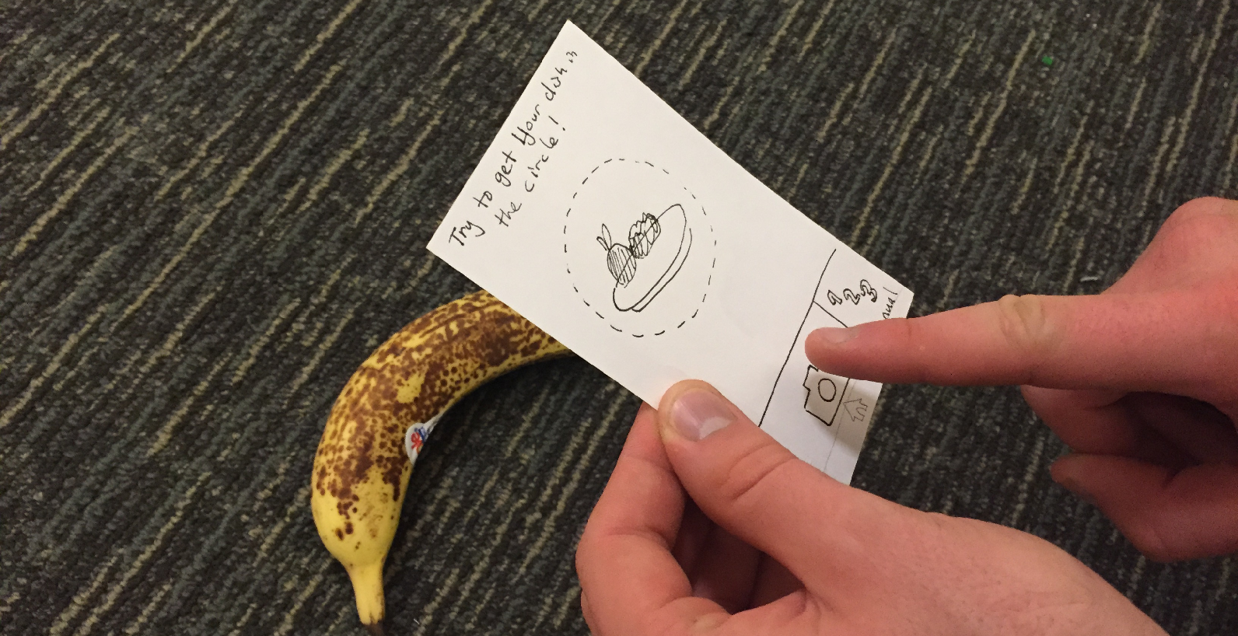

Slide 9
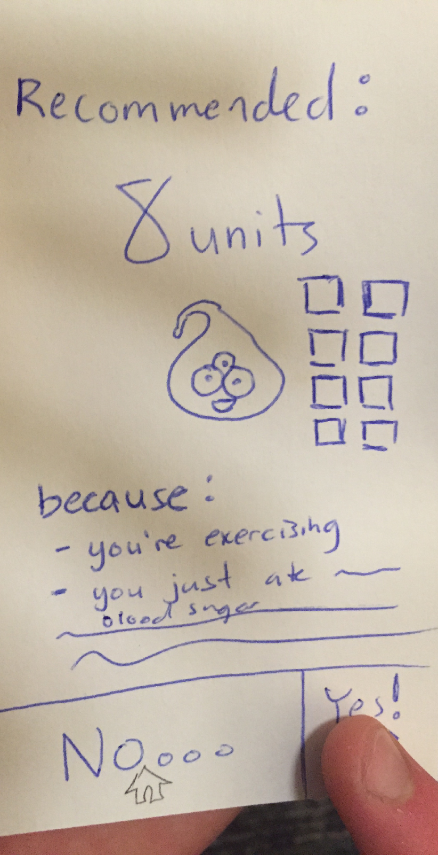

Slide 10
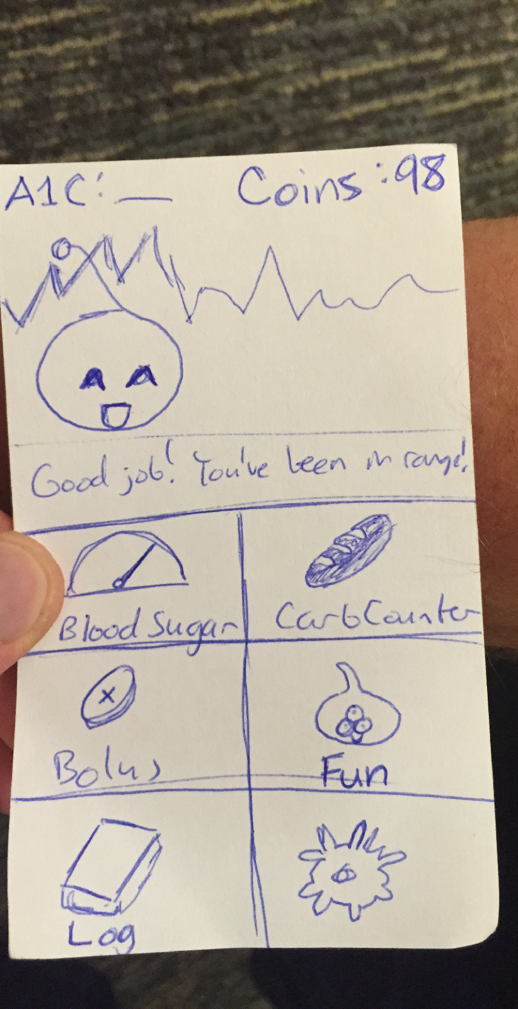

Slide 11
Results
Counting carbs took longest,~2 min
Bolusing took ~1 min
Testing blood sugar took shortest ~30 sec
Sorting through data analysis needed a lot of explanation

Slide 12
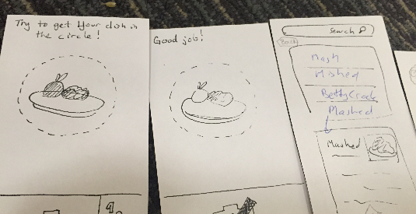

Slide 13
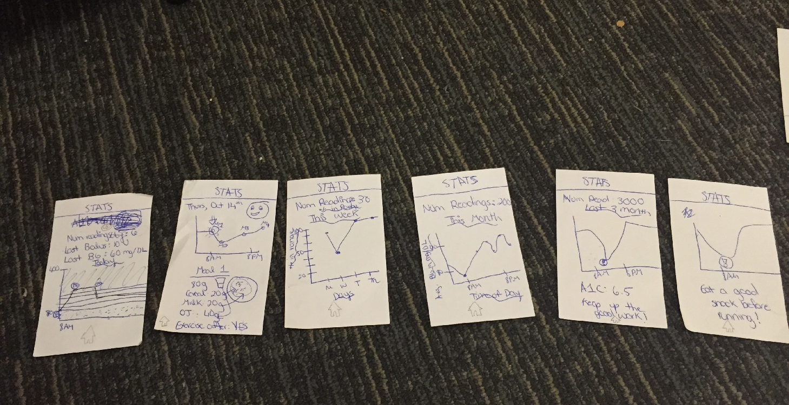

Slide 14
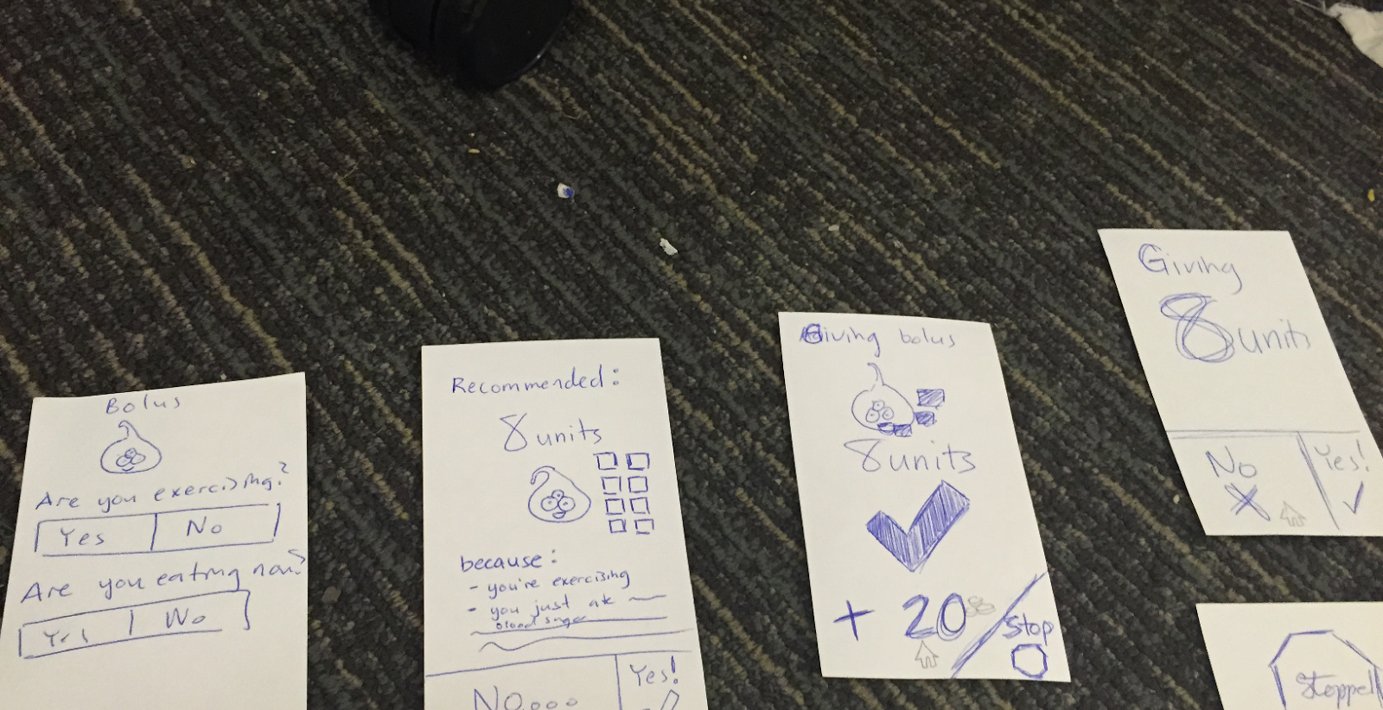

Slide 15
Suggested UI Changes
Tab Bar View Controller for graphs, instead of relying on pinch gesture
Confusion about what check mark means after carb count
  Bolus too technical for a term
Not letting very young kids change important aspects

Slide 16
Summary
All participants felt this device had potential
Displaying data effectively biggest challenge
Cute worked.

